Slide 1

Harvest Foodbank
& you!
Notes:
Delivery notes are in square brackets [ ] , other notes are suggested narrative to use with the slides.
Slide 8 outlines a little activity you can do from the front which will need some preparation and three volunteer children, to help everyone engage with the content of your presentation.
The rest of the presentation should work as a way to help the group explore Harvest and food bank activity, which then leads into your call to action.

Slide 2



Harvest & Food Bank Quiz
True
  Hands on heart
False
  Hands on head
Notes:
Let’s have a little True or False quiz to get us warmed up.
True – hand on head
False – hands on heart

Slide 3
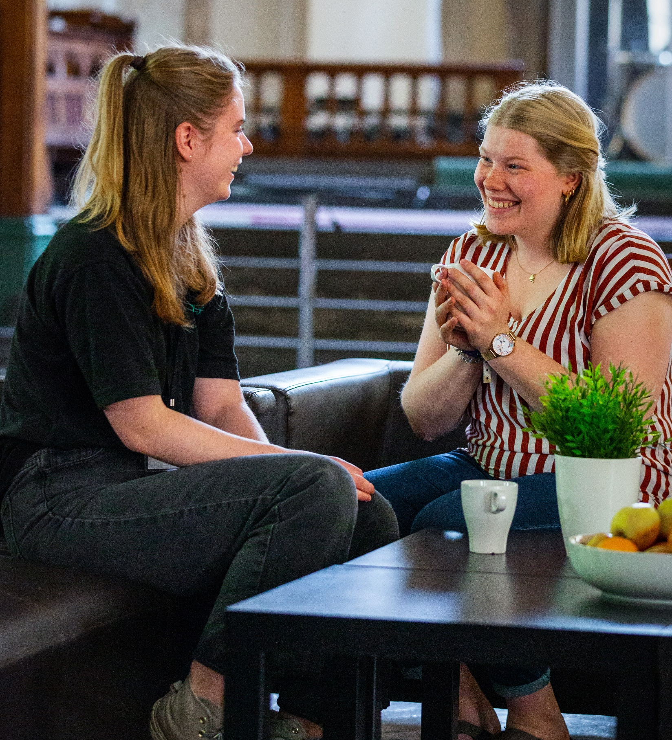
Harvest is always in October
1.
Guidance notes – Remove before use
[Change the month to match the date you’re presenting in]
False –
It changes based on the moon calendar (when the moon changes shape in the night sky!), and anyway different churches and other traditions celebrate it at different times.
But, it is always about the same thing: being thankful for what we have, like the food we have grown.
Notes:
[Change the month to match the date you’re presenting in]
False –
It changes based on the moon calendar (when the moon changes shape in the night sky!), and anyway different churches and other traditions celebrate it at different times.
But, it is always about the same thing: being thankful for what we have, like the food we have grown.

Slide 4
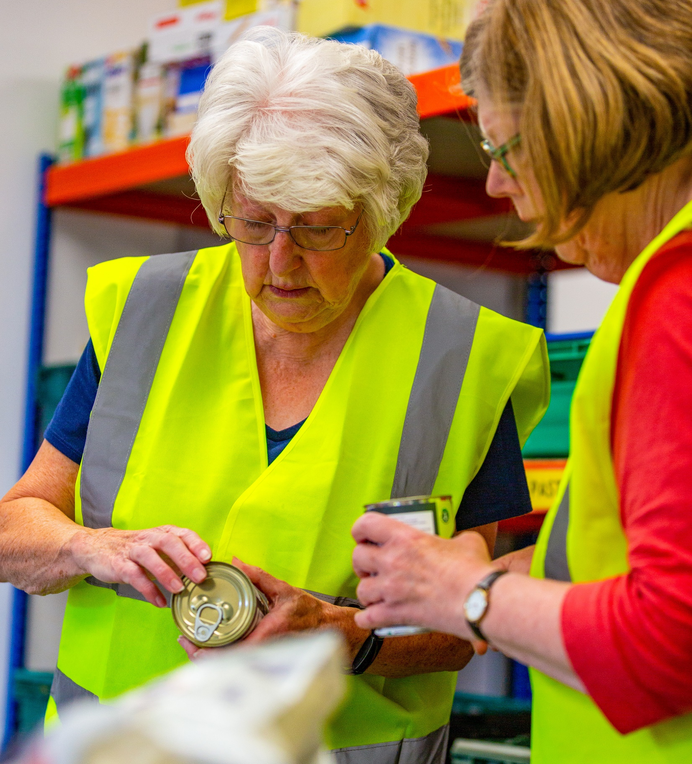
You could help the foodbank
2.
Guidance notes – Remove before use
True –
Foodbanks are doing their best to help people but we all have a part to play in ending hunger together, any donations of food make a real difference! You can also help by letting other people know the foodbank is there.
Notes:
True –
Foodbanks are doing their best to help people but we all have a part to play in ending hunger together, any donations of food make a real difference! You can also help by letting other people know the foodbank is there.

Slide 5
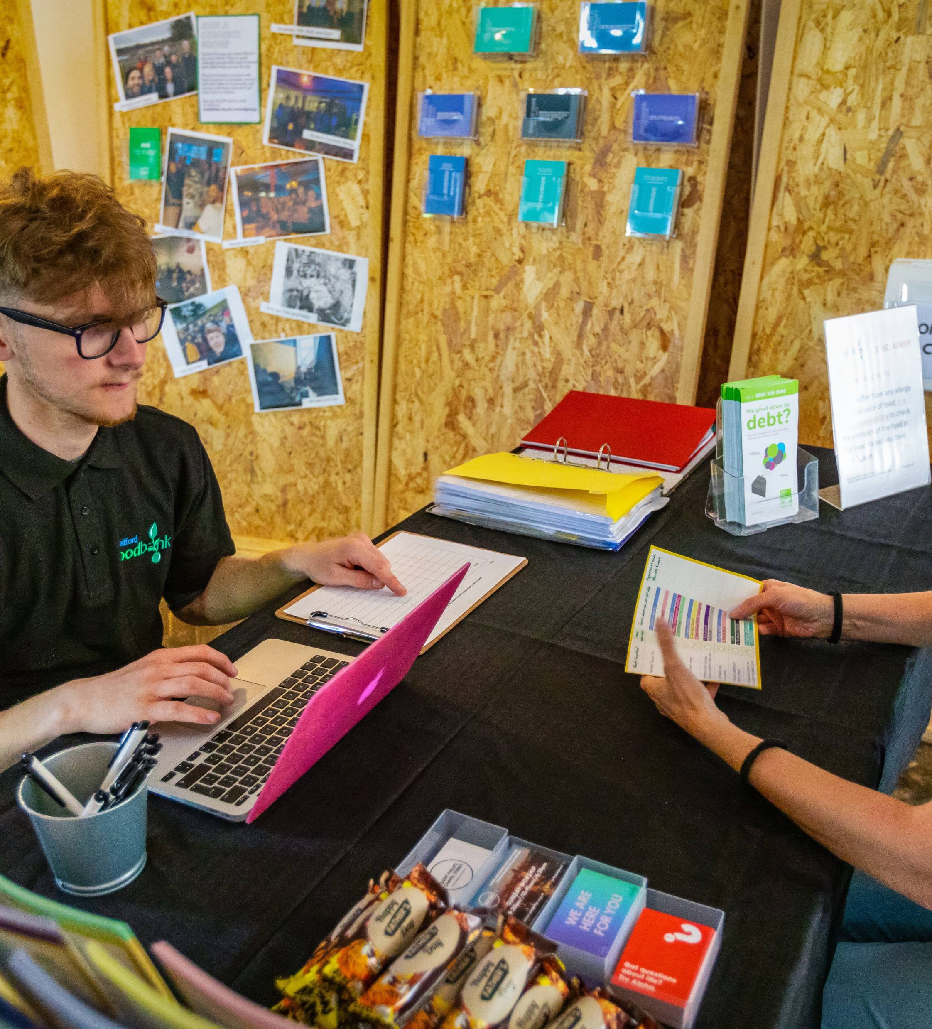
Salford Foodbank opens at Harvest to help people
3.
Guidance notes – Remove before use
False –
Foodbank is open all year round and helps people in a few different ways
Notes:
False:
Salford Foodbank is open all year round and helps people in a few different ways

Slide 6
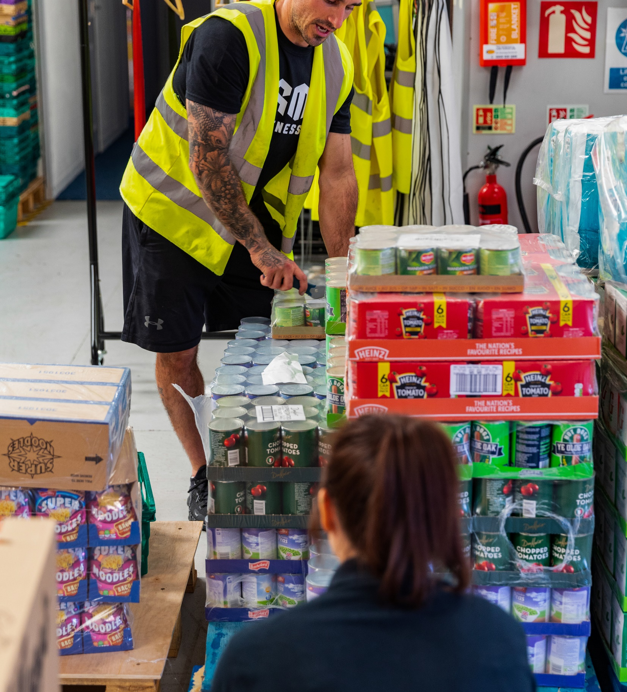
Ending hunger is about more than food
4.
Guidance notes – Remove before use
True -
Foodbanks help people with emergency food, but we all have a part to play in ending hunger, let’s have a think about this next.
Notes:
True -
Foodbanks help people with emergency food, but we all have a part to play in ending hunger, let’s have a think about this next.

Slide 7





Guidance notes – Remove before use
What do you think you could do to help people?
Here are some ideas…
Notice… when someone needs help – [this point tries to show how the system can often not be very supportive and we need to see the people the system affects]
[Consider inviting thoughts on how can we do this, without guessing things about people (using stereotypes - making guesses about someone based on appearances) and without judging (thinking we know what people should get based on the little we do know about them. E.g. Notice how people might be feeling, try to imagine if we were in their situation, be kind to everyone]
Create… (e.g. free activities and clubs in school or church)
Listen… (be a friend who is ready to listen and know who you can ask for help, e.g. teachers in your school)
Donate… [see next slides]
What can you do?
Notice
  When someone needs help
  guessing
  judging
Help your food bank
  Please give to
  our food bank this Harvest
Create
  Space and activities
  that everyone can enjoy
Listen
  And know who else to ask for help
Notes:
What do you think you could do to help people?
Here are some ideas…
Notice… when someone needs help – [this point tries to show how the system can often not be very supportive and we need to see the people the system affects]
[Consider inviting thoughts on how can we do this, without guessing things about people (using stereotypes - making guesses about someone based on appearances) and without judging (thinking we know what people should get based on the little we do know about them. E.g. Notice how people might be feeling, try to imagine if we were in their situation, be kind to everyone]
Create… (e.g. free activities and clubs in school or church)
Listen… (be a friend who is ready to listen and know who you can ask for help, e.g. teachers in your school)
Donate… [see next slides]

Slide 8
What are food banks doing?
Guidance notes – Remove before use
[Collect three pillow cases, a packet of pasta (or similar), a pen and letter in an envelope, and a tea cup. Pop each item in a pillow case, invite children to put their hand in and guess what the item is inside, and then take it out and ask for ideas of what it represents of what foodbanks are doing. Summarise this with the next slide.]
Notes:
[Collect a three pillow cases, a packet of pasta (or similar), a pen and letter in an envelope, and a tea cup. Pop each item in a pillow case, invite children to put their hand in and guess what the item is inside, and then take it out and ask for ideas of what it represents of what foodbanks are doing. Summarise this with the next slide.]

Slide 9

Guidance notes – Remove before use
[Click forward to talk about each point once all three items have been picked out]
As a foodbank we…
We have a caring conversation with everyone we support, it’s not just about the food, but treating everyone as someone who needs care and has value. Foodbanks also give advice to people and put them in touch with other organisations that can help them. Having a caring conversation is something we can all do wherever we are, in church, school, in public
Are sending a message, foodbanks and Trussell are working together with lots of other charities and organisations to make sure the UK government knows we want a change - so people won’t need to use food banks any more. Trussell and many food banks are asking for an Essentials Guarantee, which would mean everyone would have enough money to be able to buy what they need. If you’re interested in this, you can find out more on our website trussell.org.uk
Giving out food to people and families who need it. While we wait for changes so everyone has enough money to buy what they need, you can help by donating food this Harvest
What are food banks doing?
A caring conversation
  A friendly chat, cup of tea and advice for people who visit
Sending a message
  So we don’t need food banks anymore.
  (Like writing to MPs)
Give out food
  Support people while it’s needed
Notes:
[Click forward to talk about each point once all three items have been picked out]
As a foodbank we…
We have a caring conversation with everyone we support, it’s not just about the food, but treating everyone as someone who needs care and has value. Foodbanks also give advice to people and put them in touch with other organisations that can help them. Having a caring conversation is something we can all do wherever we are, in church, school, in public
Are sending a message, foodbanks and Trussell are working together with lots of other charities and organisations to make sure the UK government knows we want a change - so people won’t need to use food banks any more. Trussell and many food banks are asking for an Essentials Guarantee, which would mean everyone would have enough money to be able to buy what they need. If you’re interested in this, you can find out more on our website trussell.org.uk
Giving out food to people and families who need it. While we wait for changes so everyone has enough money to buy what they need, you can help by donating food this Harvest

Slide 10


Harvest Food Bank donations
Give food this Harvest…
Give money this Harvest…
Shopping list
Tinned meat/fish
Tinned veg/soup/fruit
Rice & Pasta
Coffee & Tea
UHT Milk
Cereals
Fruit juice (long-life)
Shampoo & Deodorant
Pasta Sauce
Biscuit & Snacks
Help to cover the costs of storing and distributing food, as well as developing sustainable projects.
Donate money through saford.foodbank.org.uk
Notes:
[Add details of how to donate to your food bank, or other things you are doing with the school e.g. letter home or collections]

Slide 11
Will you play your part?

Slide 12
Salford.foodbank.org.uk
Salfordfoodbank

